Slide 1


Tasmanian Ports Corporation Pty Ltd
VS
CSL Australia Pty Ltd (The Goliath) [2025] FCAFC 53
Legal Case Analysis for Engineering Management and Risk Allocation
Group number:21 Course code:ENGG5204

Slide 2

Executive Summary
Conclusion
A port collision with major legal and management implications
MV Goliath, two tugboats and port infrastructure at Devonport Port. The Full Federal Court’s decision is significant because it affects how liability exposure is understood in high-risk engineering and maritime operations.
Incident
Legal Issue
Management Impact
The dispute followed a serious collision at Devonport Port involving MV Goliath, two tugboats and port infrastructure, with damage, sinking and pollution-related consequences.
The central question was whether wreck removal and related recovery costs could be limited under Australia’s maritime liability framework.
The decision highlights the need for stronger contract drafting, risk allocation, insurance review and governance in engineering operations.

Slide 3
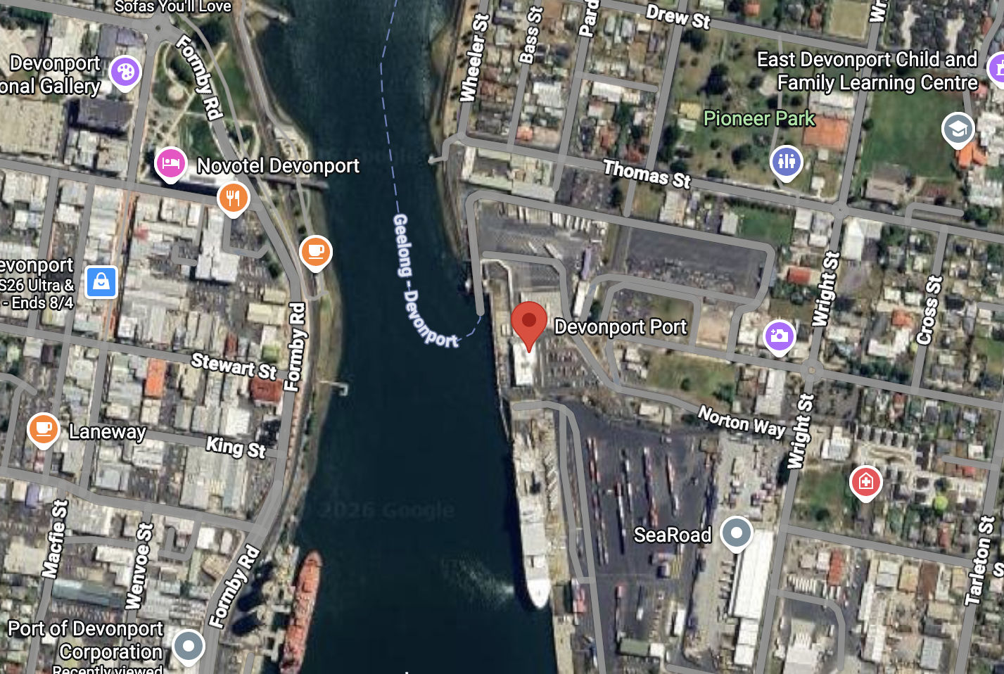
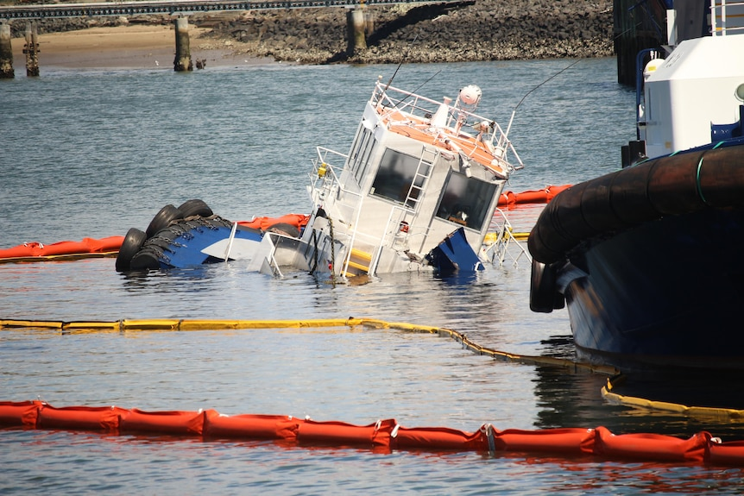
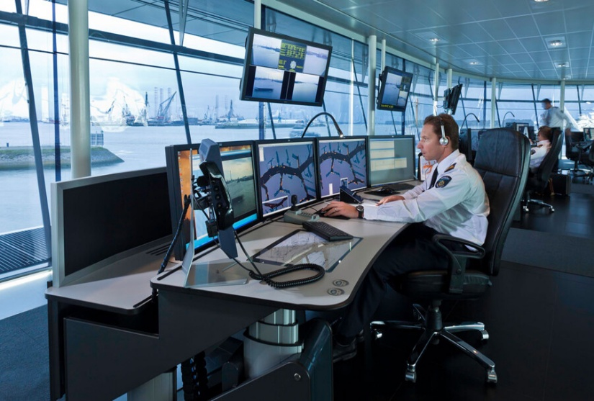

Industry Context
Briefly introduce the background of the case
Add your title
Add your title
Operational Environment
Risk Exposure
Governance Relevance
The case arose in a high-risk port setting involving vessel movement, tug assistance and port infrastructure.
The collision created damage, sinking and recovery-related consequences across technical, financial and environmental domains.
The case highlights why engineering managers need stronger contracts, incident response systems and risk governance.

Slide 4
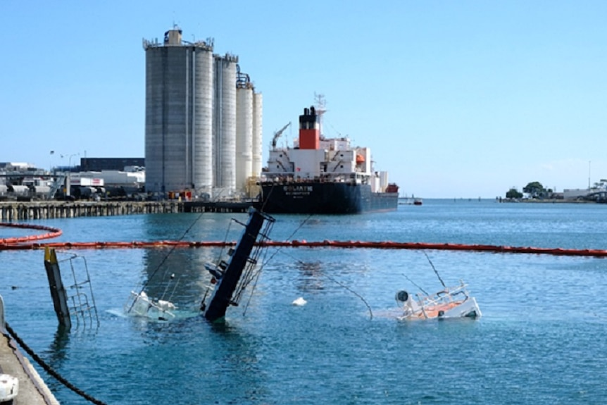
Parties & Background
Overview of the main parties and incident background
Party | Role
Tasmanian Ports Corporation Pty Ltd (TasPorts) | Port operator and owner of relevant port assets, including the tugboats and infrastructure involved in the incident
CSL Australia Pty Ltd | Operator/owner associated with MV Goliath
MV Goliath | Cement carrier involved in the collision
Incident Background
The incident occurred during port operations at Devonport and involved MV Goliath, two tugboats and port infrastructure. It resulted in damage, sinking and recovery-related consequences that later formed the basis of the legal dispute.

Slide 5
Timeline of Events
Full Court allowed the appeal and held the relevant wreck removal claims were not limitable in Australia.
29 Apr 2025
The appeal was heard by the Full Federal Court.
6–7 Mar 2025
26 Jul 2024
Primary orders were made on the limitation issue.
TasPorts filed its notice of cross-claim in the substantive proceedings.
18 Oct 2023
Collision at Devonport: MV Goliath struck two TasPorts tugboats, which later sank.
28 Jan 2022

Slide 6
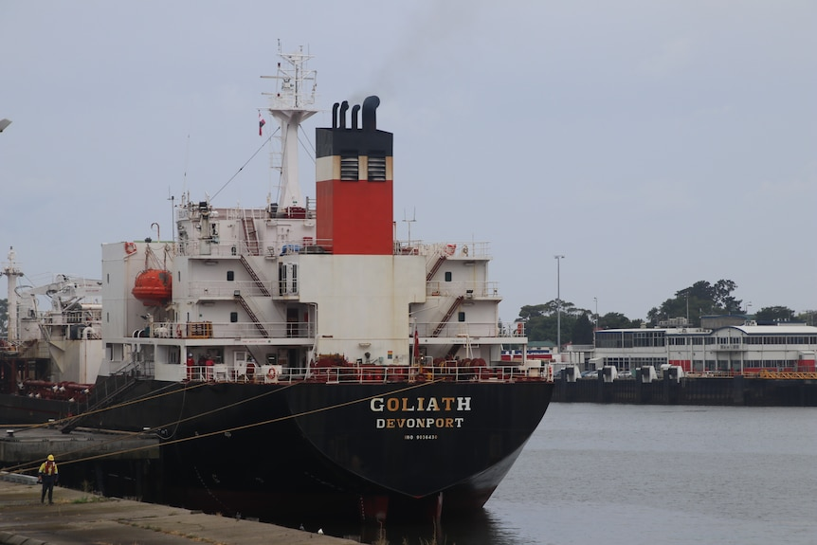
Legal Issues in Plain English
The dispute was about whether wreck removal costs were outside the liability cap in Australia.
The key question was whether CSL could legally cap what it had to pay TasPorts.
TasPorts said the disputed costs were wreck removal costs, and those kinds of claims are not limitable in Australia.
CSL said the claims could still fall within the broader limitation regime.
So the Court had to decide which interpretation of the Convention was correct.

Slide 7
The Competing Arguments
Both parties agreed that major recovery costs had arisen, but they disagreed on
whether those claims could be limited under Australian law.
01
TasPorts argued
02
CSL argued
The disputed costs were wreck removal claims within Art 2(1)(d).
Australia has exercised its reservation under Art 18(1), so Arts 2(1)(d) and (e) do not apply in Australian domestic law.
Therefore, the relevant claims could not be subject to limitation in Australia.
The primary judgment should be upheld.
Even if the claims related to wreck removal, they could still remain within the broader limitation regime.
CSL also argued that Art 2(1)(d) should be read as applying only to the “limiting ship.”
VS
The key disagreement was whether wreck removal-related costs were outside the liability cap in Australia.

Slide 8
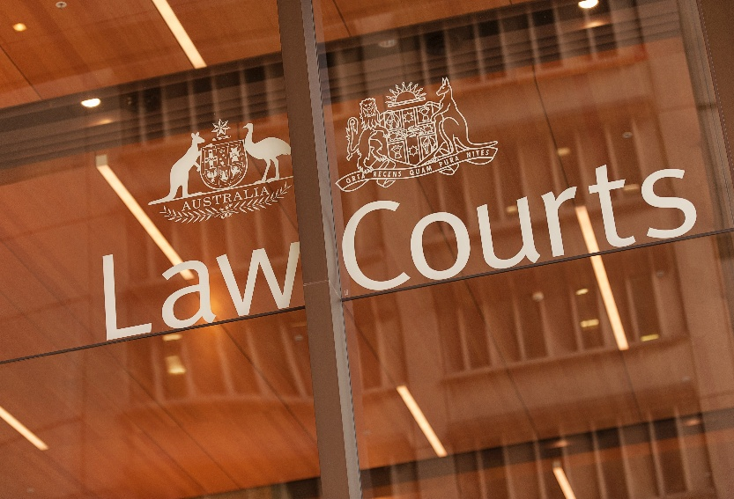
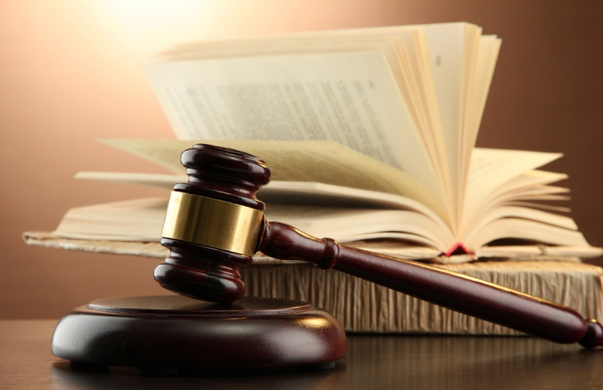
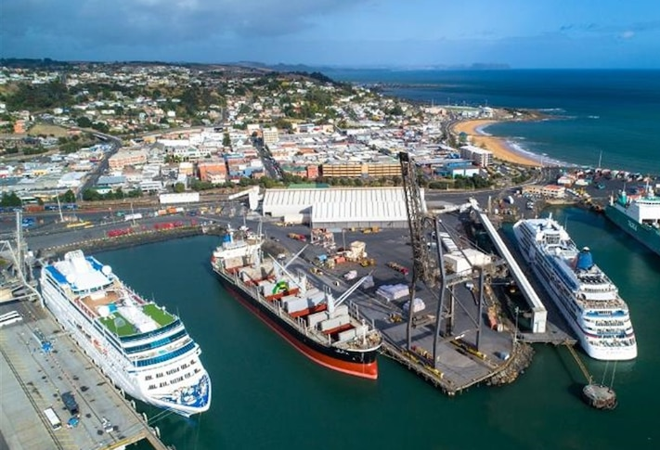
Court’s Decision and Why It Matters
Outcome
Court Order
Practical Effect
TasPorts succeeded on appeal. The Full Federal Court allowed the appeal and set aside the relevant orders made on 26 July 2024.
The Court declared that CSL was not entitled to limit its liability to TasPorts for claims concerning the raising, removal, destruction or rendering harmless of the sunken tugs Campbell Cove and York Cove, including anything that had been on board them.
This meant that the relevant wreck removal-related claims were outside the liability cap in Australia. The appeal did not finally quantify damages, but it removed CSL’s ability to cap this category of exposure.
In the top “Start” panel, you can modify the fonts, font size, color, and row spacing, etc
In the top “Start” panel, you can modify the fonts, font size, color, and row spacing, etc
In the top “Start” panel, you can modify the fonts, font size, color, and row spacing, etc

Slide 9
Engineering and Management Implications
The case shows that major post-incident costs may fall outside the liability cap,
increasing the importance of contracts, response systems and governance.
Higher Risk Exposure
Operational Response Matters
Stronger Governance Needed
The decision shows that wreck removal-related claims may not be capped in Australia, which can significantly increase financial exposure after a major operational incident.
Recovery, removal, pollution control and evidence management are not only technical tasks; they can shape later legal and commercial outcomes.
Engineering managers need clearer contracts, better interface management, stronger escalation processes and more robust governance in high-risk operations.
In the top “Start” panel, you can modify the fonts, font size, color, and row spacing, etc
In the top “Start” panel, you can modify the fonts, font size, color, and row spacing, etc
In the top “Start” panel, you can modify the fonts, font size, color, and row spacing, etc

Slide 10
Contractual Lessons
contracts must address uncapped exposure more clearly after major operational incidents.
Practical
Skills
Key Contract Risks
What Contracts Should Do Better
Wreck removal and recovery costs may fall outside the liability cap in Australia.
Post-incident exposure may extend beyond physical damage to recovery, disposal and pollution response.
Multiple parties and assets increase interface risk.
Allocate responsibility for wreck removal and related costs expressly.
Clarify indemnities, notice requirements and escalation procedures.
Define obligations between operators, contractors and insurers clearly.
Strengthen reporting, documentation and evidence-retention requirements.

Slide 11
What Would We Do Differently Today?
Focus on stronger contracts, response systems, documentation and governance.
Develop clearer escalation, coordination and emergency-response procedures after major operational incidents.
Review whether current governance, assurance and insurance arrangements match the real scale of operational risk.
Review Contracts
Strengthen Incident Response
Improve Evidence Retention
Reassess Governance
Reassess contracts to ensure wreck removal, recovery and post-incident liabilities are clearly allocated.
Ensure logs, reports, communications and technical records are preserved to support later legal and insurance processes.

Slide 12
Board-Level Recommendations
Require Board Visibility
Ensure the board has regular visibility over major operational liability exposures and post-incident response capability.
Mandate Risk Review
Require periodic review of contracts, indemnities, insurance coverage and interface risks in marine and infrastructure operations.
Strengthen Organisational Controls
Improve reporting, escalation, recordkeeping and assurance systems so that operational incidents are managed consistently and defensibly.

Slide 13
Conclusion
The case arose from a serious port collision at Devonport involving MV Goliath, two tugboats and port infrastructure.
The Full Court held that the relevant wreck removal-related claims were not limitable in Australia because of Australia’s reservation under Art 18(1).
For engineering and infrastructure managers, the lesson is clear: contracts, reporting systems, insurance review and governance must be strengthened before major incidents occur.

Slide 14
References
Australian Transport Safety Bureau. (2023). Collision involving the bulk carrier Goliath and tugs York Cove and Campbell Cove, Devonport, Tasmania, on 28 January 2022 (MO-2022-002).
Convention on Limitation of Liability for Maritime Claims, opened for signature 19 November 1976, 1456 UNTS 221 (entered into force 1 December 1986).
CSL Australia Pty Ltd v Tasmanian Ports Corporation Pty Ltd (The Goliath) [2024] FCA 824.
Limitation of Liability for Maritime Claims Act 1989 (Cth).
Solvang, T. (2016). Some reflections concerning the scope of the Maritime Code section 172a. MarIus, 482, 29–43.
Steel, D. (1995). Ships are different: The case for limitation of liability. Lloyd’s Maritime and Commercial Law Quarterly, 77–87.
Tasmanian Ports Corporation Pty Ltd v CSL Australia Pty Ltd (The Goliath) [2025] FCAFC 53.

